Slide 1

Student Details
NAME :
SKILLS BUILD EMAIL ID :
COLLEGE NAME :
COLLEGE STATE :
DOMAIN :
DURATION :
STUDENT ID :
INTERNSHIP ID :
ADUPA VIVEK
adupavivek1234@gmail.com
SR UNIVERSITY
TELANGANA
ARTIFICIAL INTELLIGENCE
12-06-2023 to 24-07-2023
STU647325ef413811685267951 INTERNSHIP_168198413964410a8b547b1

Slide 2
PROJECT TITLE/Problem Statement
MENTAL FITNESS TRACKER
The challenge is to create a mental fitness tracker using Machine Learning that strives to track and enhance a person's mental health. A vital component of total wellbeing is mental health, and many people experience stress, anxiety, depression,mental disorders and other problems. There are no comparable tools for tracking and promoting mental health, unlike traditional physical fitness trackers that concentrate on monitoring physical activity and health data.

Slide 3
AGENDA
The agenda of this project is to create an innovative mental fitness tracker that can accurately assess and monitor an individual's mental state, provide personalized insights and interventions, and promote better mental health practices using the best regreesion models. We will highlight the importance of mental well-being and the current lack of tools for mental health tracking compared to physical fitness trackers. Our objective is that the project should be user-friendly, accessible,accurate, and confidential to ensure users feel comfortable using it and trust the Machine Learning based recommendations.

Slide 4
PROJECT OVERVIEW
The Mental Fitness Tracker is a machine learning based project designed to promote and improve mental well-being among its users. The primary objective of the project is to create an accessible and user-friendly platform that empowers individuals to track and manage their emotional health effectively with an efficient model using Machine learning techniques. Various types of Regression models can be analyzed and the best model can be choosen for the best accurate prediction.The project serves a diverse range of users, including general individuals, mental health patients, therapists, corporate wellness programs, educational institutions, support groups, healthcare providers, and personal coaches.

Slide 5
WHO ARE THE END USERS of this project?
The "Mental Fitness Tracker" project is designed serve various groups of people who wish to enhance their mental well-being
General Users: Individuals interested in improving their overall mental fitness and well-being.
Mental Health Patients: People undergoing therapy or treatment for mental health issues, who can utilize the tracker to monitor their progress and manage their emotions.
Psychologists and Therapists: Mental health professionals can use this tracker to track their patients' progress and provide personalized support.
Corporate Wellness Programs: Companies can use the tracker to promote mental health among employees and keep track of stress levels.
Educational Institutions: Schools and universities can implement the tracker to support student mental health and help them cope with academic pressures.
Healthcare Providers: Medical practitioners can recommend the tracker to patients as a tool to monitor mental health alongside medical treatments

Slide 6
SOLUTION AND ITS VALUE PROPOSITION
SOLUTION:
The Mental Fitness Tracker is an machine learning project that offers a comprehensive and personalized approach to improve mental well-being. It uses the different constraints provided in the data set, Several constraints like anxiety,drug usage,alcohol and many mental disorders can be assessed ,By using several regression models,we can find the best regression model for analysis.Through this, we can analyse the percentage of mental fitness of an individual.
VALUE PROPOSITION:
Our value proposition is to offer a comprehensive and all-encompassing solution to improve emotional and mental health for both individuals and different user groups. The Mental Fitness Tracker offers a distinctive and effective method for enhancing mental health and equipping users to lead happier and more meaningful lives by combining individualized tracking, stress management tools, community support, professional integration, and educational resources.
Empowerment through Tracking
Stress Management Made Simple
Effortless Integration for Professionals
More Accurate results.

Slide 7
How did you customize the project and make it your own
The project has been customized with more data visualization techniques for better understanding of the data.
Traing and evaluating several Regression models,and sorting out the best regression model for analysis provides the most accurate output.
Following the Feature Engineering Techniques for the best prediction.
The Outliers detection in the dataset and handling the outlier,null values ,which further lead to atmost accuracy.

Slide 8
MODELLING
In this project,SVM and Random forest regression models are used for analysis.
Step by step
Process for Modelling
|--- Collect Data :Gather data from users
|
|--- Preprocess Data : Clean and preprocess the collected data. Handle missing values, normalize numerical features, and convert categorical variables into
numerical representations if necessary.
|
|--- Train Regression Models : Split the dataset into training and testing sets, Select appropriate regression models, Train the selected regression models using
the training dataset.
|
|--- Evaluate Model Performance : Evaluate the trained regression models using the testing dataset,regression tasks include Mean Squared Error (MSE), Root
Mean Squared Error (RMSE), Mean Absolute Error (MAE), and R-squared.
|
|--- Deploy Model :Check for the best regression model. Fine-tune hyperparameters of the regression models to optimize their performance. Integrate the
trained regression models into your mental fitness tracker
|
|--- Inputs Data : user inputs the relevant data
|
|--- Predict Mental Health Indicators : The models can predict mental health indicators or anxiety levels based on the input features
|--- End

Slide 9
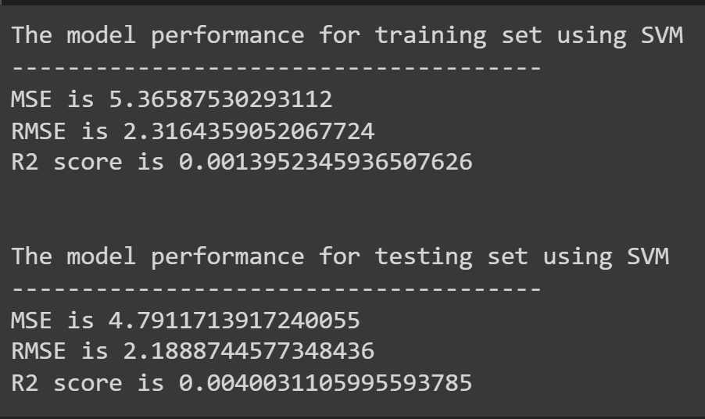
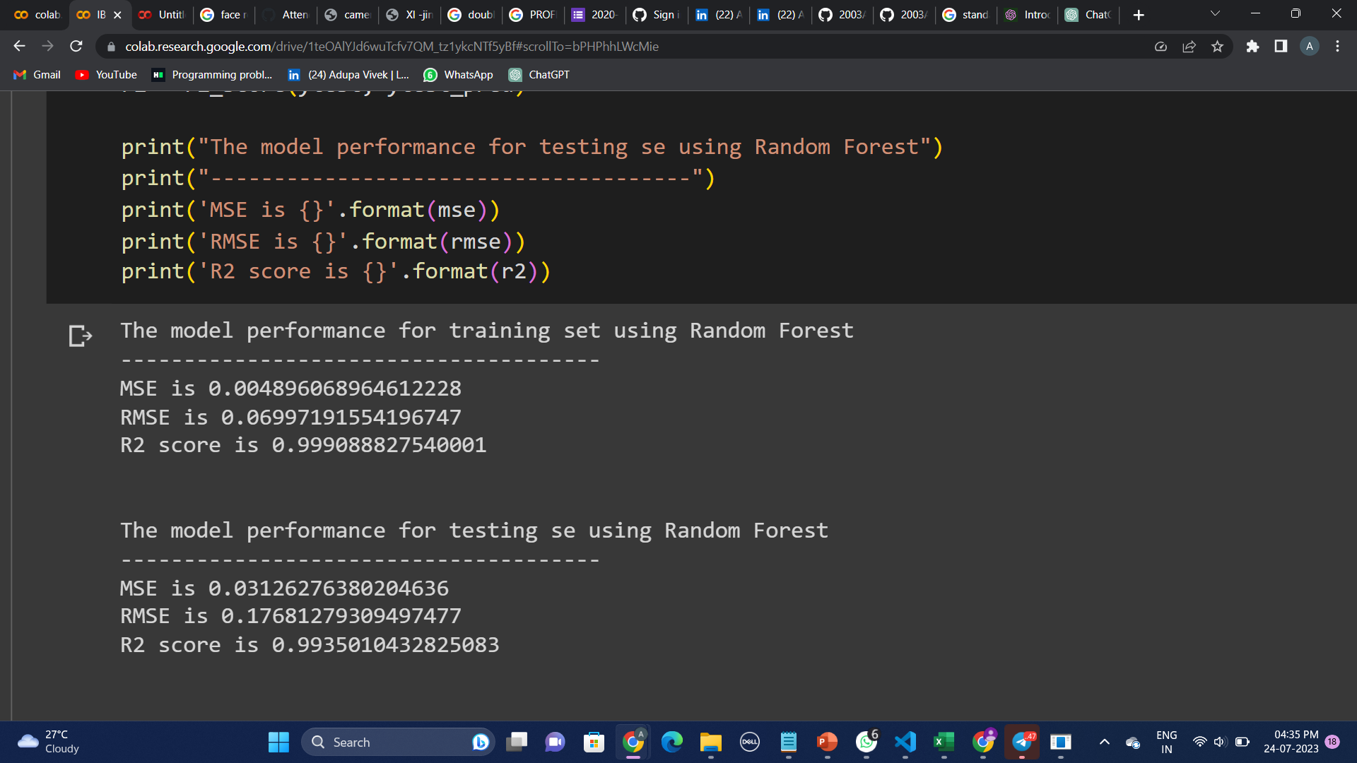

Results
The Regression models have been evaluated using evaluation metrics for regression tasks that included Mean Squared Error (MSE), Root Mean Squared Error (RMSE), Mean Absolute Error (MAE), and R-squared .
The Random Forest Regression model provided the best output.
The Random forest model can be integrated into mental fitness tracker to get accurate results.. When users input their relevant data, the models can predict mental health based on the input features with atmost accuracy.

Slide 10
links
For Python Code Execution of Project ,please click here
For Project Execution Video,Please click here

